Slide 1


03.
Machine Learning Models

Slide 2

K-Fold Cross-Validation for model selection
K = 10, which generally have best estimate
Grid Search
Exhaustive search
Specify grid for parameter search

Slide 3
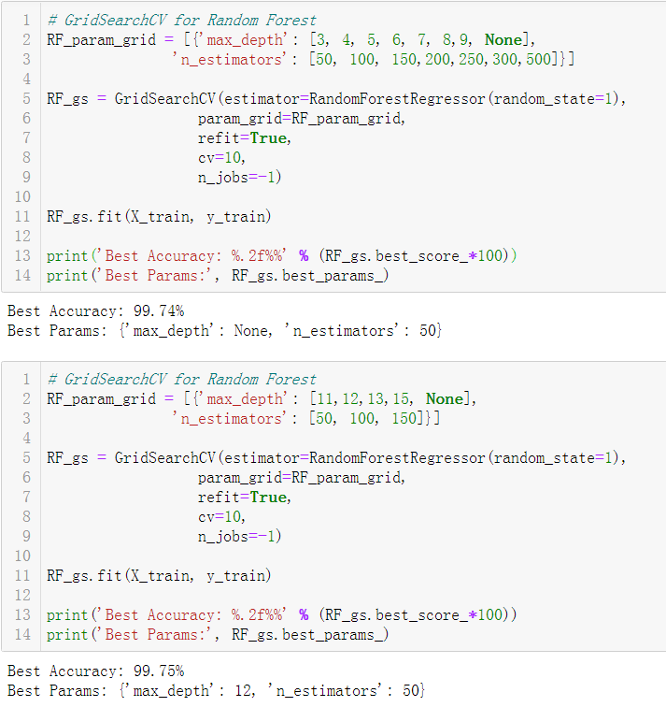
Model 1: Random Forest
Random Forests
= Bagging with Tree + random feature subsets
Advantage: general and easy to apply
Approach:
We adopted grid search to decide a range of the best hyperparameters
Conduct grid search again to find the best hyperparameters in the range we got before

Slide 4
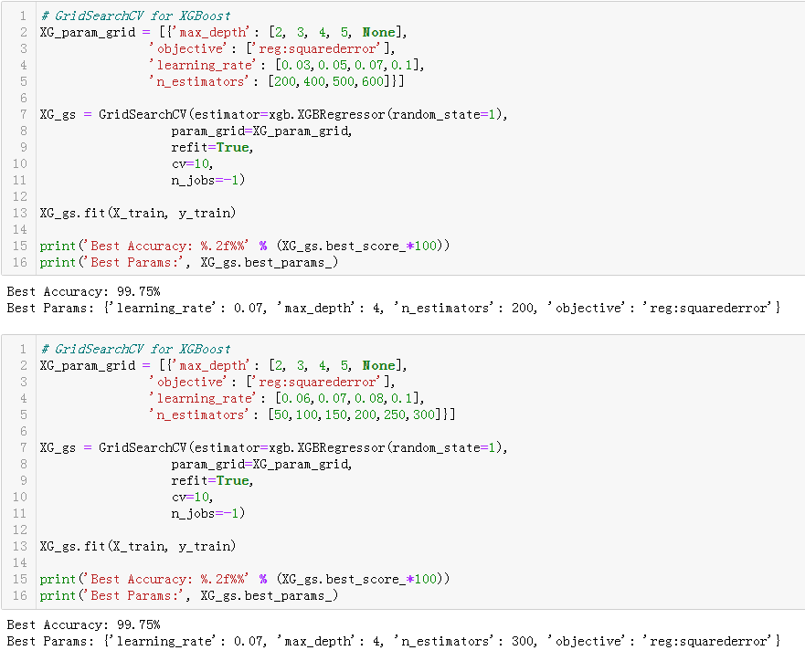
Model 2: XGBoost
Gradient Boosting generally have good performance
XGBoost is a scalable implementation of gradient boosting in large data set
Regularization term for penalizing model (tree) complexity
Applied similar approach as before

